Slide 1
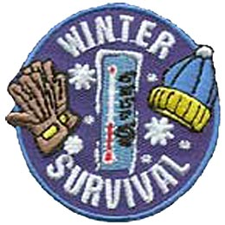
Winter Camping
Troop 344 and 9344

Slide 2

BSA Winter Camping Requirements
Conduct an outdoor encampment for a twenty-four (24) hour (minimum) period between December 1 and March 31.
The troop/patrol should not leave the campsite or area for an outside activity.
Hold four troop meetings preparing for the winter camping experience. Before any Scout can participate, the unit leader should ensure that the Scouts participating have knowledge of:
  Appropriate types of clothing, bedding and camping equipment;
  Cleanliness in cooking and care of the campsite;
  Proper practice in the care of food, menu planning, and proper sanitation;
  Proper types of fires and their uses;
  Proper skill in use of wood tools (Totin’ Chip)
  Proper training in cold weather first aid
Units may not use manufactured tents. They may use visquene, tarps or native materials.
A minimum quarter mile pack-in is suggested. With the exception of their water, units may only bring what they can backpack in one trip.
Menus must be prepared and food purchased by the Scouts. Cooking should be done individually or in teams of two.
Practice Leave-No-Trace camping, carry out what you bring in, follow the BSA Outdoor Code!
A special segment will be available for Scouts camping in BELOW ZERO weather provided they use an approved shelter and make their own ground bed. Below Zero is achieved anytime the temperature drops below zero during the outing.

Slide 3
Always Check Weather Conditions and Hazards
Know before you go (This is the golden rule for any outdoor activity.)
Check the conditions.
  Besides knowing the extreme temperatures you may be up against, stay on top of approaching weather systems and weather trends for the season and region.
Always establish a trip plan and inform appropriate parties of your whereabouts and anticipated return.

Slide 4
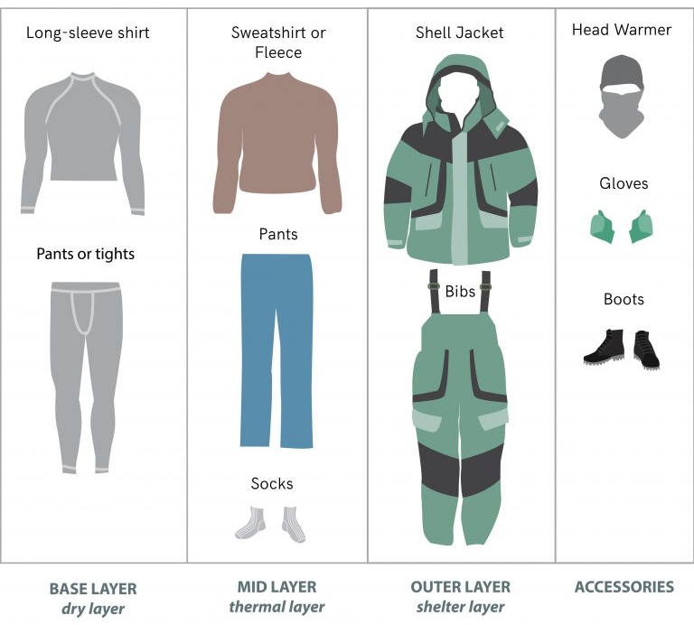
Winter Camping Clothes
There are three layers of winter camping clothing:
  Wicking – This is the Inner layer worn next to your body.
  Warmth – This is the Middle layer worn between the Inner (Wicking) and Outer (Wind And Waterproofing) layers.
  Wind And Waterproofing – This is the Outer layer worn over the Middle (Warmth) layer.

Slide 5
Wicking/Inner Clothing Layer
Your inner clothing layer should keep your body dry by drawing moisture (like body sweat) away from your skin and transferring it to the Warmth/Middle layer where it should evaporate.
You actually want this layer to be made of a thin non-plant based fabric that fits relatively snugly.
DO NOT use cotton or other plant-based materials for this layer (this is one of the most common camping safety mistakes made when camping in cold weather.)
Like the plant, cotton material absorbs water which is exactly the opposite thing you want to accomplish here so avoid cotton as your base layer.
DO use synthetic materials like polyester or animal-based materials like wool for your Wicking/Inner layer.

Slide 6
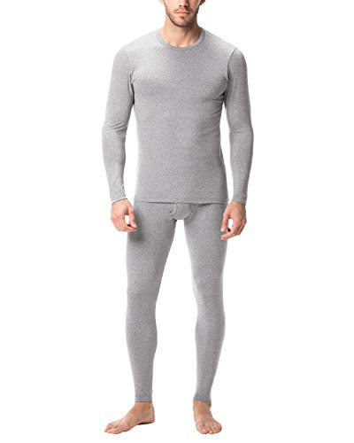
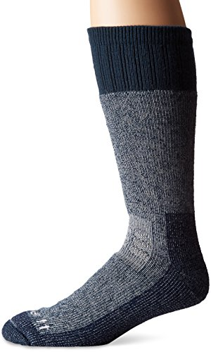
Wicking/Inner Clothing Layer
Long Johns
  Consider wearing snug-fitting long johns as your inner clothing layer when camping in cold weather.
Thermal Socks
  Consider wearing thermal heavy-duty socks to keep your feet warm and safe in cold weather.

Slide 7
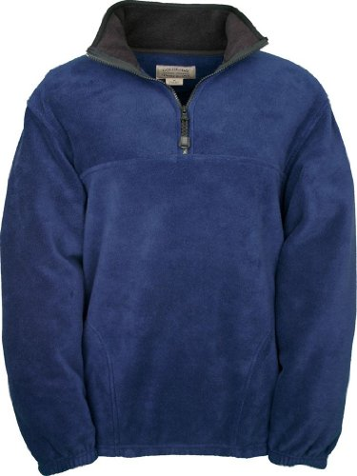
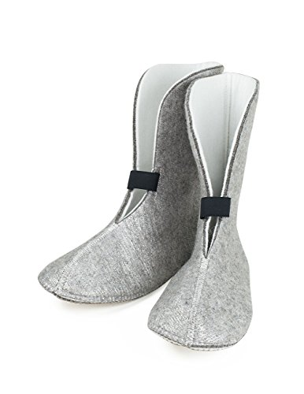
Warmth/Middle Clothing Layer
Your middle clothing layer should keep you insulated and warm.
  This clothing should be made of fleece, wool, down or synthetic insulation.
  Consider fleece jackets as the middle layer for your upper body.
Boot Liners
  Consider boot liners as your middle layer to keep your feet warm while camping in the winter.
  The warmth that wool provides is a great option as your middle layer but not a good option to be worn next to your skin or as an outer layer because wool can be itchy and dries slowly if it gets wet while most synthetic materials hold less water and dry faster.

Slide 8
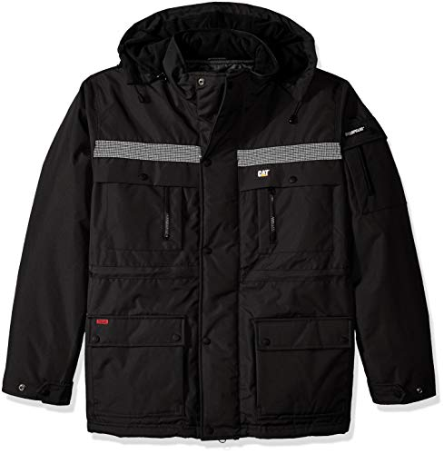
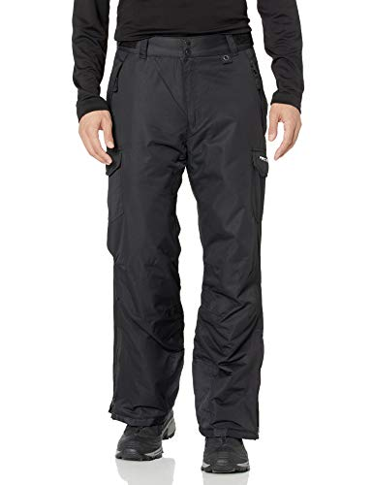
Wind and Waterproofing/Outer Clothing Layer
Your outer clothing layer should repel wind and water while keeping you warm.
It is the bulkiest layer and the first to be removed.
If you are camping in gently cold conditions, you may only need a windbreaker type of outer layer.
Extreme cold weather camping conditions will required a thicker, heavy insulted, hooded parka and snow pants-type of layer.

Slide 9
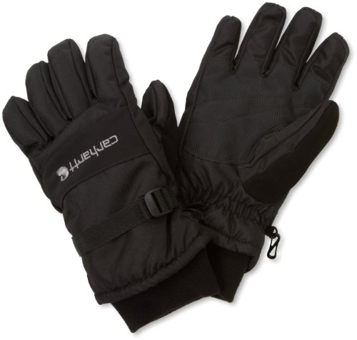
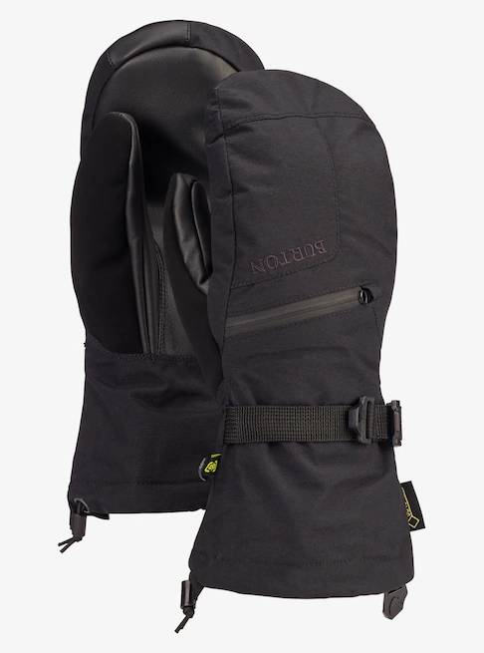
Protect Body Extremities
Cold heads and hands are a quick path to an overall cold body.
  Winter hiking gear MUST include items that keep your extremities covered and safeguarded from bitter temperatures.
Gloves And Mittens
  Use mittens or gloves to protect your hands and fingers from the elements; just make sure they are waterproof.

Slide 10

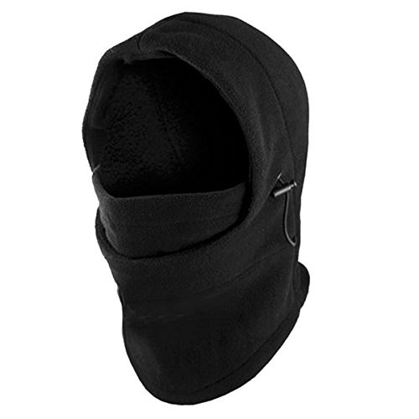
Protect Body Extremities
Hats And Balaclavas
  Wearing a hat with earflaps will prevent heat loss especially if you cover that with the hood of a coat.
  Many people don’t consider covering their face and neck but in more extreme temperatures, it is critical to cover as much skin as possible.
  Use a face mask or balaclava to cover your face and neck.

Slide 11
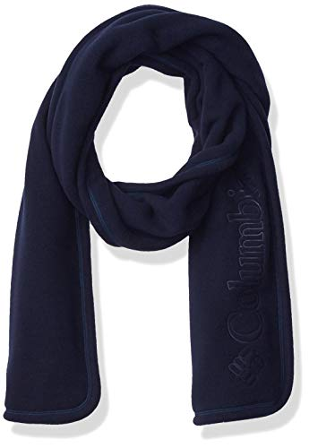
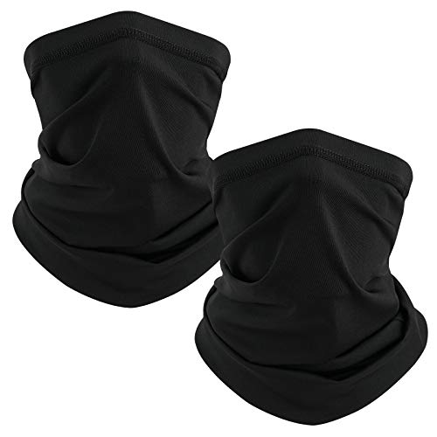
Protect Body Extremities
Neck Gaiters And Scarves
  Cover your neck and chin area from exposure to cold temperatures during daytime activities as well as overnight while you sleep.

Slide 12
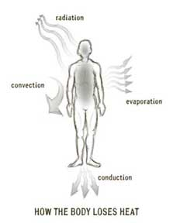
Winter Bedding
How Does Your Body Lose Heat?
  Evaporation: Evaporation causes a cooling effect. The body loses 85% of its heat through sweating during intense exercise. Wet clothes from sweating and increased respiration also trigger a drop in body heat.
  Radiation: This normal process of heat moving away from the body usually occurs in air temperatures lower than 68°F (20°C). The body loses 65% of its heat through radiation.
  Conduction: Conduction is the transfer of heat from physical contact. Conduction is responsible for the loss of body heat from sleeping on the cold ground.
  Convection: Heat loss by air or water moving across the skin surface when exposed to cold air.

Slide 13
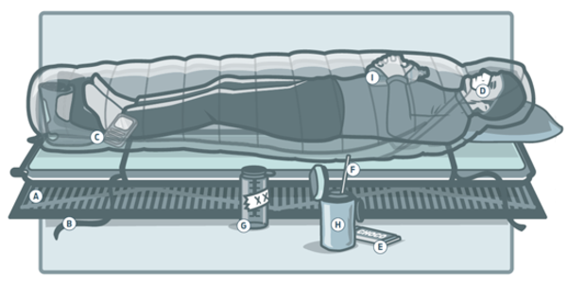
Bring an Insulated, Closed-Cell Foam Sleeping Pad
Conduction is the culprit for the heat loss that occurs when sleeping on the cold ground, and even a “warm” cold-weather sleeping bag is a cold bag without a quality, insulated pad underneath it.
Most self-inflating air mattresses only insulate down to about 30°F, so if you want comfort, lay down a closed-cell foam pad first (B).
Then throw your self-inflating mattress on top (A).

Slide 14
Warm Up With a Hot Water Bottle
If you put a hot, non-insulated stainless-steel water bottle in your sleeping bag at night, it will radiate heat like a sauna stone (I). Try tucking your makeshift heater next to one of these critical areas: your core, your inner thigh (near your femoral artery), and your neck (near your jugular).

Slide 15
Protect Your Extremities
Nothing hurts more than ramming your feet into frozen boots in the morning. Stash your boot liners in the bottom of your bag (C) to keep them warm.
Your body prioritizes warming your core, so keep your hands and feet warm to conserve energy. Wear a synthetic blend or high-quality wool sock for moisture reduction and odor management. (Don’t forget the gloves!)

Slide 16
Don’t Breathe or Burrow Deep Into Your Bag
Moisture from your breath will get trapped in the bag. Instead, cinch the draft collar and close the hood down around your mouth and nose so you have a blowhole to breathe through (D). This is especially true if you use a down sleeping bag. Condensation is the death of a down bag. A wet bag significantly loses its insulation and takes time to dry.

Slide 17
Wear the Right Clothes for Sleeping in Cold Temperatures
Never wear your day clothing to bed but rather change into bedtime clothing.
  Any dampness in your day clothing will cool you down.
For temperatures below 30°F, be sure to outfit yourself in appropriate base layers:
  Avoid tight-fitting clothing that may restrict blood flow to your extremities.
  Avoid running too warm (moisture will get trapped in your bag and will cause an overall drop in body temperature as you cool off).
  Wear synthetic fabrics or wool.
  Consider warm socks, fingered gloves, and a cozy cap.
  Cotton clothing does not wick moisture and may drop your body temperature.

Slide 18
Munch on a High-Calorie Midnight Snack
If you wake up cold in the middle of the night, eat a candy bar to fuel your engine. Your body runs on fuel, so fuel it up. The closer you can eat to bed time, the better. Opt for calorie-dense foods like chocolate (E), cheese, and nuts. A warm meal requiring minimal prep right before bed will give your body an added boost.

Slide 19
Prevent Spills on Your Dry Gear
Nothing would be more frustrating than spilling liquid on your dry gear (second to dehydration). Hydration is a must for keeping warm, so keep a straw near your water bottle for no-mess drinking in the middle of the night (F).

Slide 20
Don’t Hold Your Pee in at Night
If nature calls in the middle of the night, don’t procrastinate; this makes you colder in the long run because your body has to burn calories to keep urine warm. Too cold to drop pants? Consider using a pee bottle (G). Make your pee bottle distinct. You do not want to mix up your pee bottle and your drinking bottle in the middle of the night.

Slide 21
Insulate Your Water Bottles
In high altitude and in extreme weather, you’re at a greater risk of dehydration. Frozen water not only drops body temperature but makes rehydration difficult. Keep your water from freezing at night by insulating your water bottle (H). Keep your core body temperature up and stay hydrated by sipping on something warm.

Slide 22
Protect Your Electronics from the Cold
Cold weather can drain battery power fast, or even worse, permanently damage electronics. Stow your electronics, batteries, and anything else you don’t want to freeze in the foot of your sleeping bag (C). Your electronics have maximum and minimum storage and operating temperatures, so it’s wise to check these out before winter activities. Operating or charging an electronic device outside of its specified temperature range can cause irreparable damage.

Slide 23

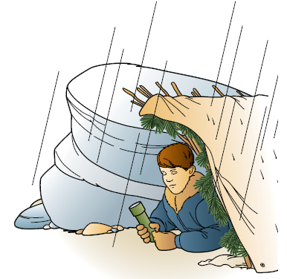
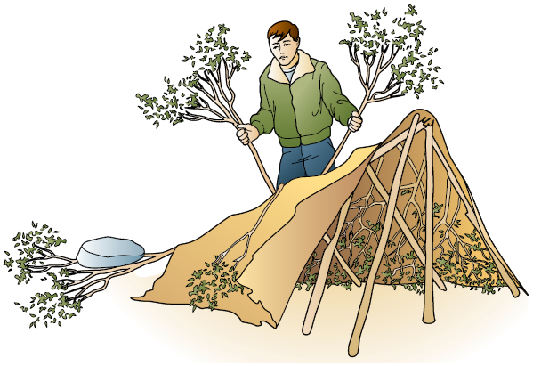
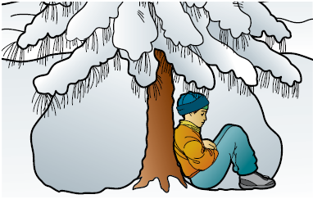
Shelter
Assemble a shelter that does the job but that takes as little energy as possible for you to set up.
The smaller the shelter the easier it is to build and heat. Most beginners build their shelters way too big.
Before building a shelter, think about how you will build it and then locate the right site for it.

Slide 24
Locating Your Shelter
If you go camping in winter, picking the right shelter site will increase your level of comfort and can also protect you from injury.
Here are some basic guidelines:
  Check the trees as dead branches and those heavily burdened with snow can snap, causing injury or harm.
  Avoid valleys and lower spots because cold air settles in depressions and will be colder.
  Avoid the tops of hills, which can be exposed to wind.
  Try to find natural wind breaks. Wind will strip heat from you through a process known as convection.
  Point your door downhill. This will prevent cold air from flowing into your shelter when you need to go outside.
  Flatten the snow under your shelter. If the site you have selected is not level, you can shovel snow onto it to level it out.
  Sites that get morning sun will warm up faster in winter.

Slide 25
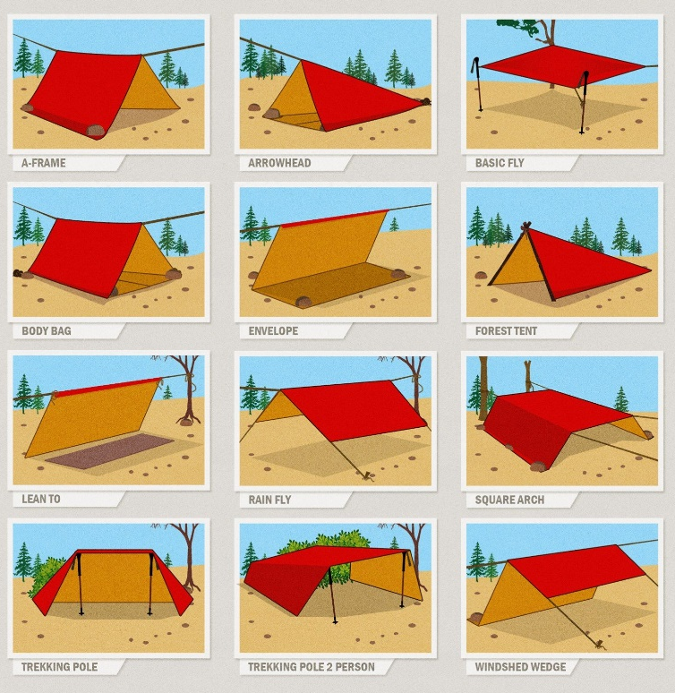
Tarp Shelters with One Tarp and some Paracord

Slide 26
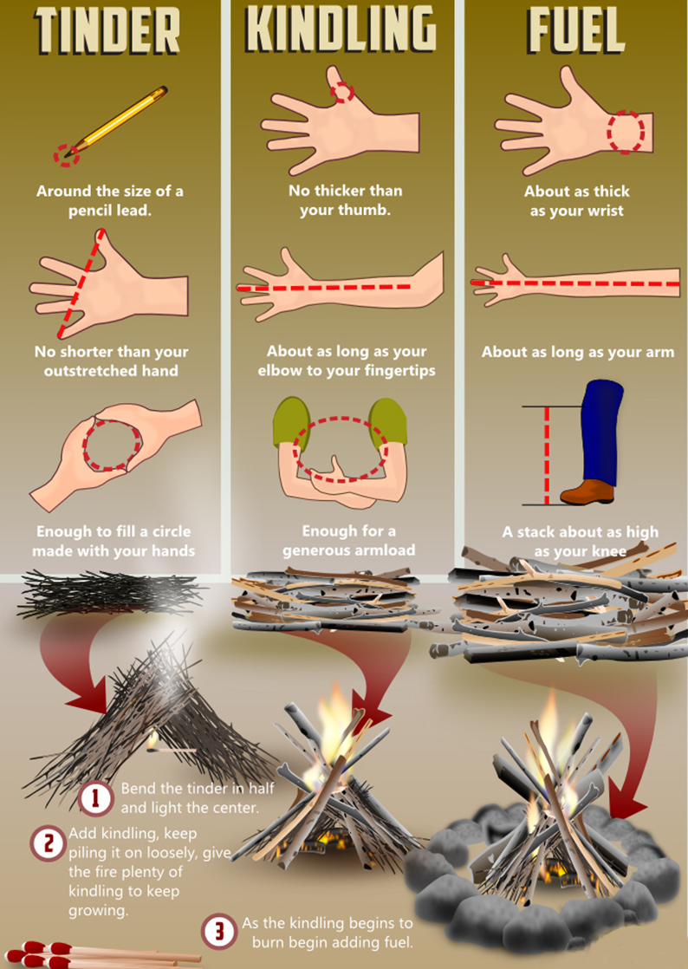
How to Build a Campfire
Gather tinder, kindling and fuel together in the sizes and quantities shown to the left before any matches are struck.
Build the fire by adding kindling wood to the burning tinder and then adding fuel to the fire as it grows. No need for a fancy fire lay, build it as you go.
Tinder from dead twigs found on the lower branches of trees and shrubs that snaps off easily when bent. No green wood!
Kindling should be dry. Don’t gather wet wood from the forest floor. Look for branches that are dead and down, not on the tree.
Fuel should be dry. Split larger wood if possible and have a good sized stack on hand before you light the fire.

Slide 27
Winter Camping Meals
During the winter, you’re going to need a lot more extra calories to keep going and to stay warm, even when you are inactive (sleeping.)
The carbs, fat, and protein in a well-balanced meal provide a store of fuel to burn in cold temperatures.
What Is a Good Carb, Protein, and Fat Ratio?
50% Carbohydrates
  Simple carbohydrates are carbohydrates from starches and sugars that provide immediate energy. Some examples are candy bars, fruits, and syrups.
20% Protein
  Provide slower, long-term energy. Found in foods such as meat, cheese, milk, grains, bean, and nuts.
30% Fats
  Fats take the longest to metabolize, providing long-term energy. They have more than twice as many calories per pound than carbohydrates and proteins, making them great for winter hiking and camping. These types of foods are oils, butter, nuts, cheese, and meats such as salami, pepperoni, and sausage.

Slide 28
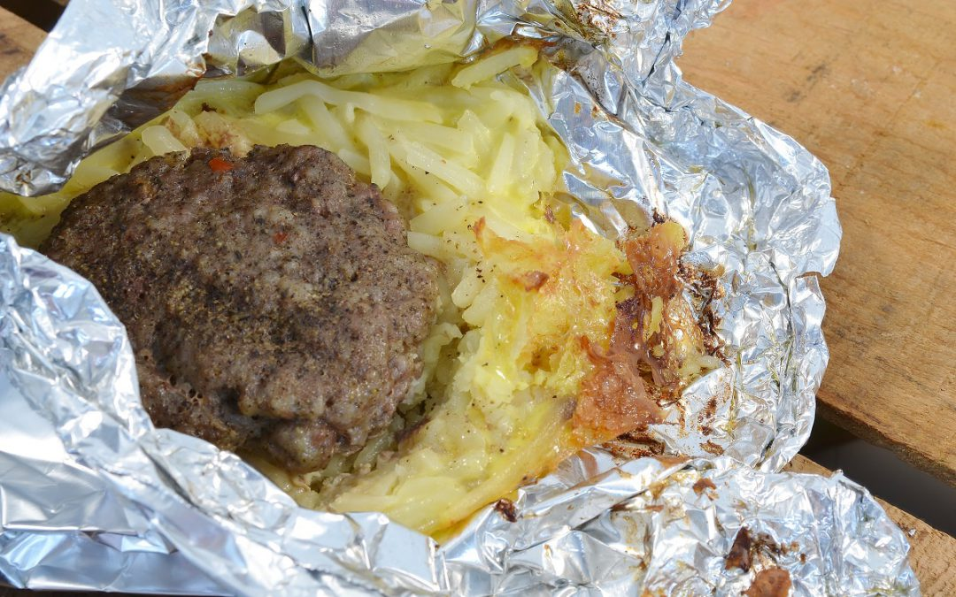

Winter Camping Meals
When it comes to cooking meals while winter camping, you’ll want to have hot meals to help you stay warm, but minimize the amount of prep work and clean-up you have to do on-site.
Your best bet is to plan meals that allow you to do as much of the prep work ahead of time, and minimize the amount of dishes that will have to be cleaned after your meals.

Slide 29
Winter Camping Meals
Boil-in-Bag Meal
  This basically includes any meal that can be reheated or cooked by boiling in water in a silicon bag or other heat friendly sealed bag.
Foil-Wrapped Meals (download instructions and recipes)
  Aluminum foil is a staple with camp cooking, even more so in the winter when you just want to cook your meal over an open fire and "throw out" your cooking dishes.
Cook-on-a-Stick Foods
  Example: Pig-in-a-Blanket
Just-Add-Hot-Water Foods
  Dehydrated camp meals, instant oatmeal.
Warm Drinks
  While coffee and tea don’t have many calories, hot cocoa can have upwards of 200 calories per package.
  Hot cocoa can also be used for emergencies to treat hypothermia in the field.

Slide 30
Drinking Water in the Winter
Cold air is dryer and you will lose water through perspiration and breathing without realizing it.
Being dehydrated in the winter will cause you to become tired, sluggish, and get cold faster.
You’ll be amazed how fast you can perk up after having enough water.
Some tips for staying hydrated in the winter:
  Drink extra in the morning. This will help wake you up and get you ready for the day.
  Drink even though you don’t feel thirsty.
  Soups and hot beverages will add fluids and calories.
  Don’t avoid drinking just because you feel cold. Drink up and start moving if you need to warm up.
  Don’t avoid drinking to limit yourself from peeing.
  Keep drinking as water helps maintain body temperature.

Slide 31
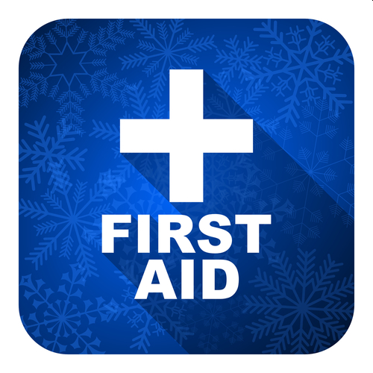
Winter First Aid
Scouts participating must have proper training in cold weather first aid and injuries that may occur during a winter campout.

Slide 32
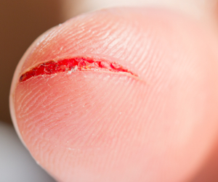
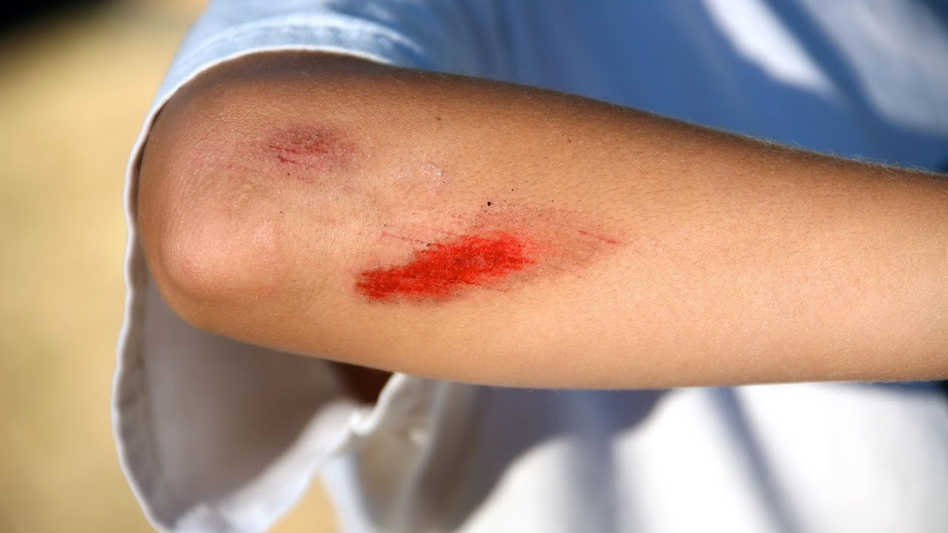
Simple Cuts and Scratches
Simple cuts are skin injuries caused by sharp objects.
  Usually not very deep
Scratches are areas of damage to the upper layers of skin.

Slide 33

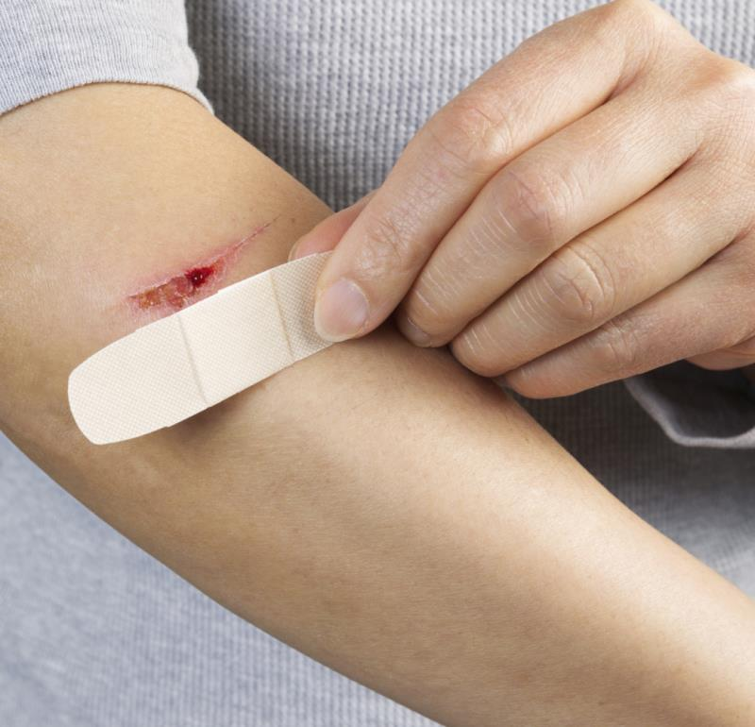
Treatment for Cuts and Scratches
Wash the wound with soap and water for 5 minutes.
  Remove any bits of dirt, small pieces of rock, or other debris.
Apply an antibiotic ointment such as Neosporin and cover it with a Band-Aid or gauze.

Slide 34
Common Mistakes in Treating Cuts and Scratches
  Don't use alcohol or Merthiolate on open wounds. They sting and damage normal tissue.
  Don't kiss an open wound because the wound will become contaminated by the many germs in a person's mouth. No kissing the Boo Boo!
  Let the scab fall off by itself; picking it off may cause a scar.

Slide 35
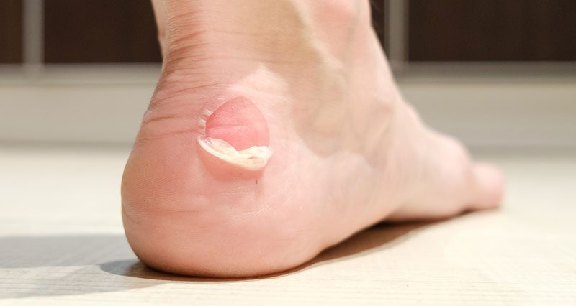
Blisters
A blister is skin injury that is usually filled with water.
Blisters commonly occur on the feet or hands.
They are most often caused by the hands or feet rubbing against something (such as wearing new shoes).

Slide 36
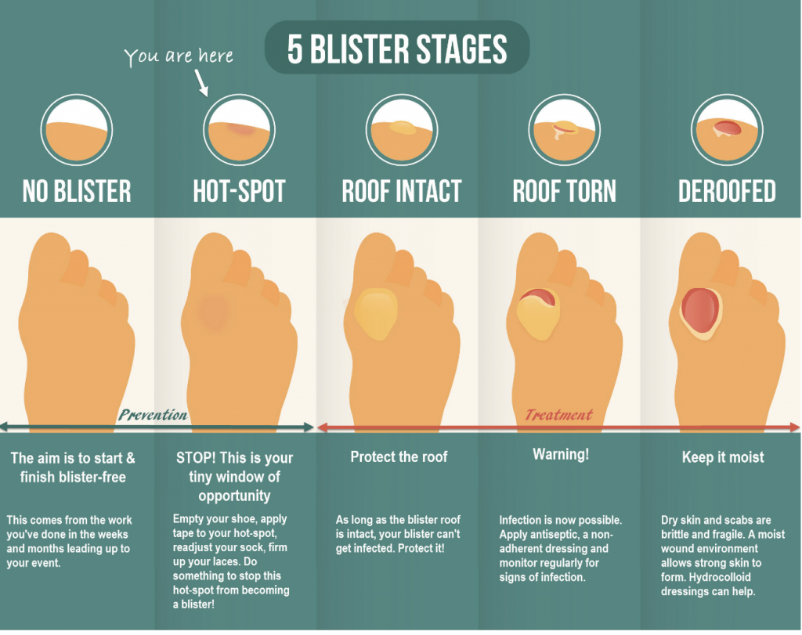

Slide 37
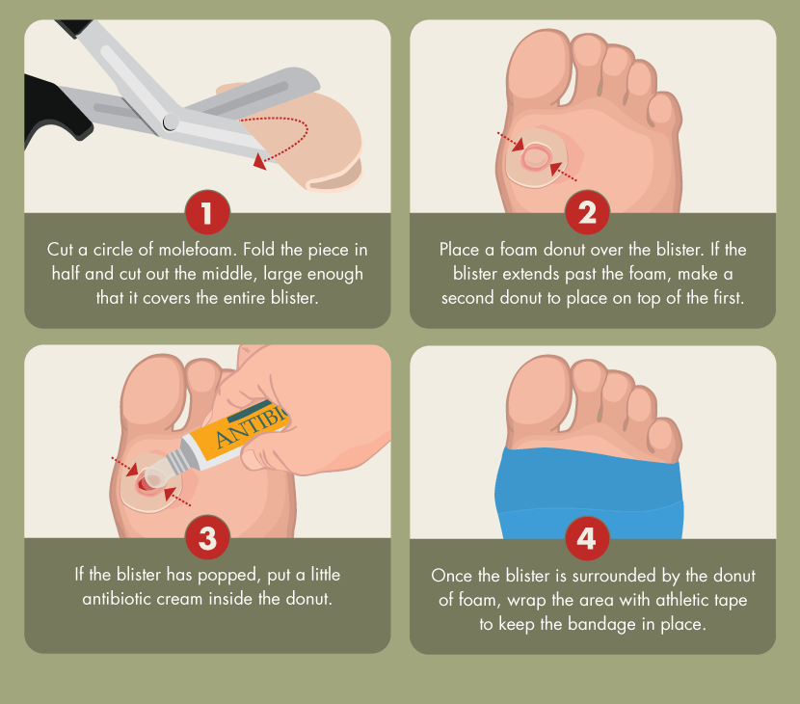
Treatment for Blisters
Do not open the blisters, since this increases the possibility of infection.
Clean the skin around it.
Take the pressure off the area by placing a Band-Aid over the blister or Moleskin with a hole cut in the center.
If the blister accidentally breaks open, trim off the loose skin.
Keep the surface clean by washing it twice a day with an antibacterial soap (such as Dial or Safeguard).
Apply an antibiotic ointment and a Band-Aid to help with healing.

Slide 38
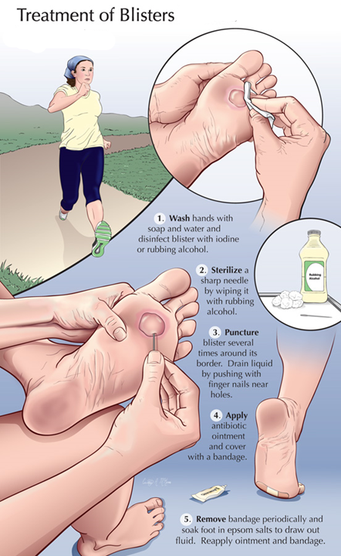
Popping a Blister
If a blister is in a frequently used area that has a high risk of rupturing, it may be best to pop it to make sure it’s properly protected against infection.
Wash your hands and the blister thoroughly.
Disinfect a needle with alcohol.
Carefully puncture the blister.
  Poke three or four shallow holes around the edge of the blister.
  You want to keep as much of the skin intact as possible.
  Allow the fluid to drain out.
Cover the blister with a first aid ointment such as Neosporin.
Apply a dressing.
  Cover the blister tightly with a bandage or gauze.
Repeat if necessary.
  You may need to perform these steps every six to eight hours for the first 24 hours.
  After that, change the dressing and apply ointment daily.

Slide 39
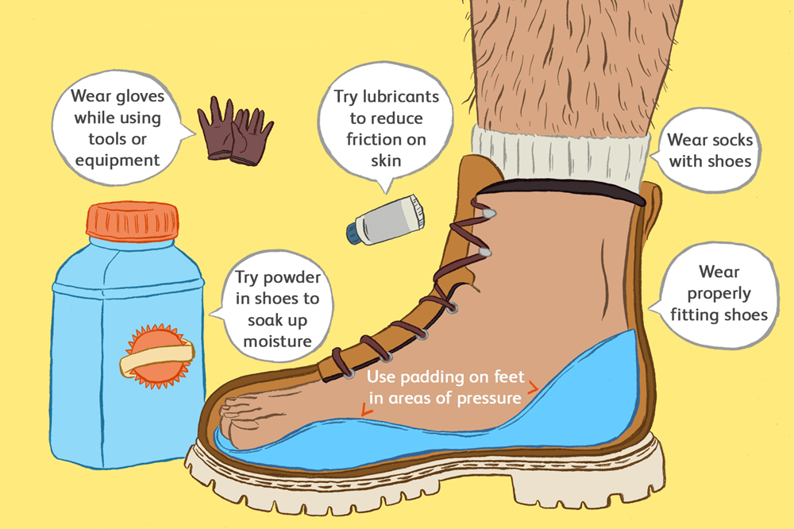
Preventing Blisters
Friction can also be reduced by wearing two pairs of socks.
Place Moleskin on sensitive areas were the friction may occur.

Slide 40
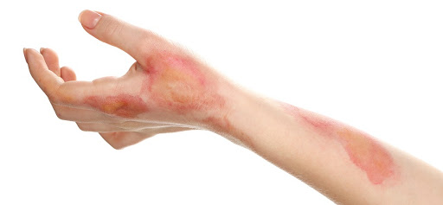
Burns
The type of burn is not based on the cause of it. Scalding, for example, can cause all three burns, depending on how hot the liquid is and how long it stays in contact with the skin.

Slide 41
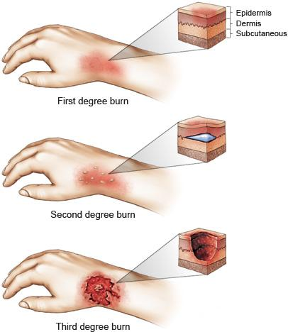
How Bad is the Burn?
First-degree burns affect the epidermis and are considered mild compared to other burns.
  Red, non-blistered skin.
Second-degree burns (partial thickness burns) affect the epidermis and the dermis (lower layer of skin). They cause pain, redness, swelling, and blistering.
  Blisters and some thickening of the skin.
Third-degree burns (full thickness burns) go through the dermis and affect deeper tissues.
  Widespread thickness with a white, leathery appearance.

Slide 42

Minor burns/scalds (1st degree)
A first degree burn is reddened skin without blisters.
Immediately put the burned part in cold tap water for 10 minutes.
This will lessen the depth of the burn and relieve pain.

Slide 43
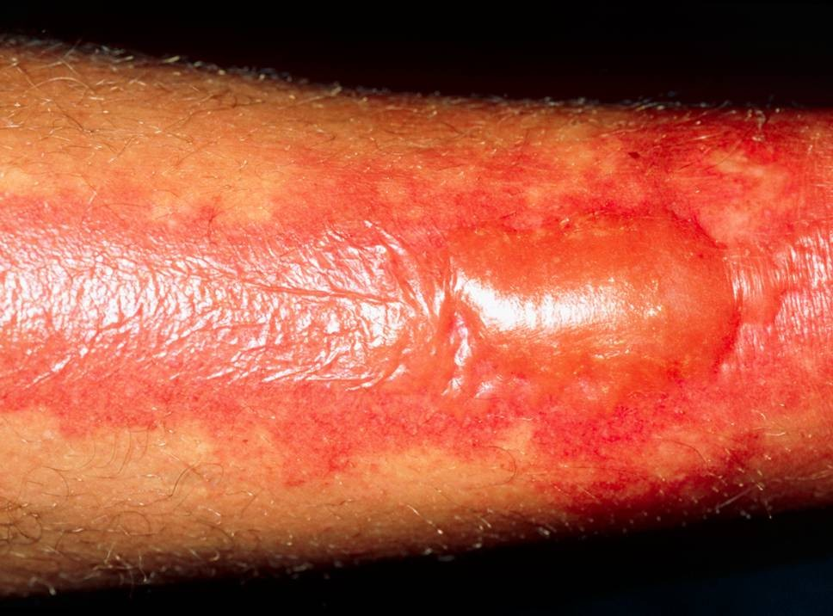
2nd Degree Burns
Symptoms:
  Causes the skin to blister and become extremely red and sore.
  Some blisters pop open, giving the burn a wet or weeping appearance.
Treatment:
  Run the skin under cool water for 15 minutes or longer.
  Take over-the-counter pain medication (acetaminophen or ibuprofen)
  Apply antibiotic cream to blisters.
  Seek emergency medical treatment if the burn affects a widespread area, such as any of the following: Face, hands, buttocks, groin, feet.

Slide 44

Frost Nip
Frost nip is an earlier and milder case of frostbite. Usually the ears, cheeks, nose, fingers and toes are affected.
Skin white or numb.
Don’t rub – hold against a warm body part.
Change clothing and/or environment.
Frost nip is a warning that you are not keeping warm enough!

Slide 45
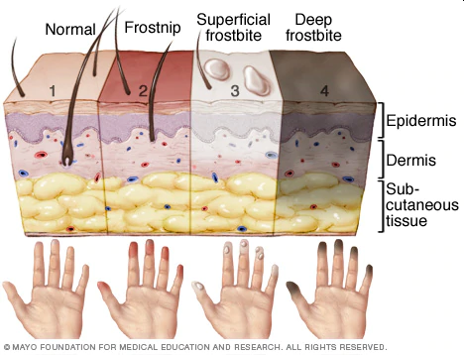
Frostbite
Mild Frostbite:
  Skin looks waxy and white, gray, yellow, or bluish.
  Area is numb or feels tingly or aching.
Severe Frostbite:
  Area feels hard.
  May become painless.
  After warming, area becomes swollen and may blister.

Slide 46
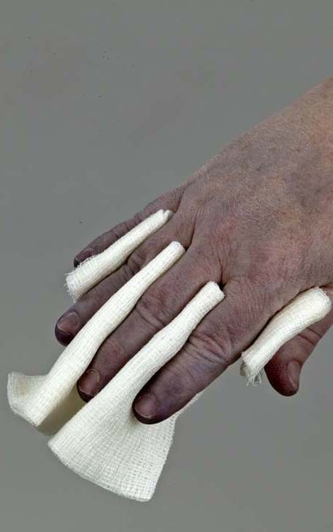
First Aid for Frostbite
Move victim to warm environment.
Hold frostbitten area in hands to warm – do not rub.
Remove any tight clothing or jewelry around area.
Put dry gauze or fluffy cloth between frostbitten fingers or toes.
Do not use heat lamp, campfire, or heating pad to rewarm.
Seek medical attention immediately.

Slide 47
Prevention of Frostbite
Be sure you dress in layers for cold weather.
  The first layer should be thermal underwear, and the outer layer needs to be waterproof.
  The layers should be loose, not tight.
  Mittens are warmer than gloves.
You should wear a hat.
  Over 50% of a your body heat is lost from the head.
Set limits on the time spent outdoors when the wind-chill temperature falls below 0°F (-18°C).
Recognize the earliest warnings of frostbite.
  Tingling and numbness are reminders that your are not dressed warmly enough for the weather and needs to go indoors.

Slide 48
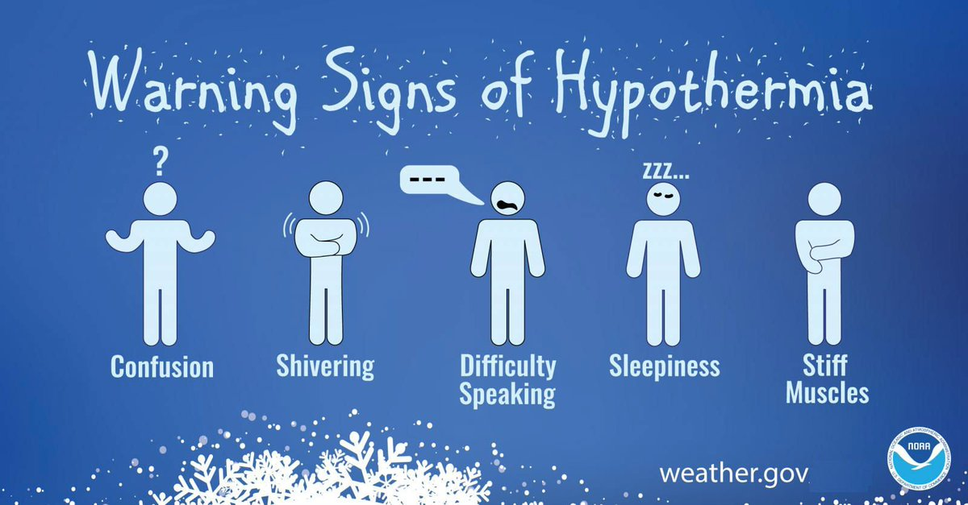
Hypothermia
Occurs when body cannot make heat as fast as it loses it.
Internal body temperature drops below 95ºF.
Can occur whenever and wherever a person feels cold, including indoors in poorly heated areas.

Slide 49
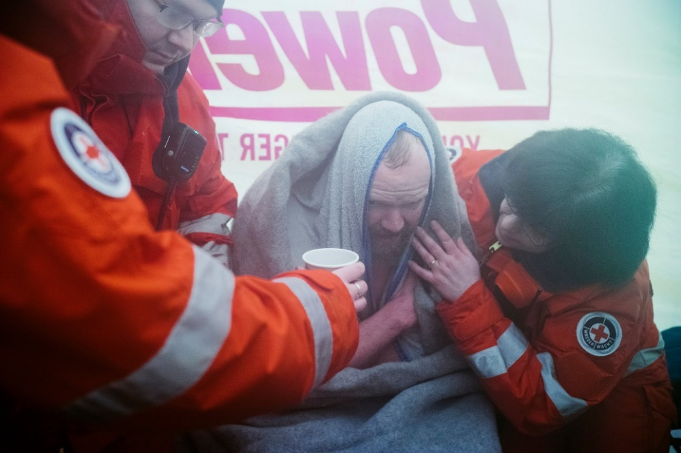
First Aid for Hypothermia
Move victim to shelter.
Remove wet clothing and wrap victim in warm covers.
Apply direct body heat.
Re-warm neck, chest, abdomen, and groin first.
Give warm, sweet drinks if conscious.
Monitor breathing, administer CPR.
Get medical help.

Slide 50
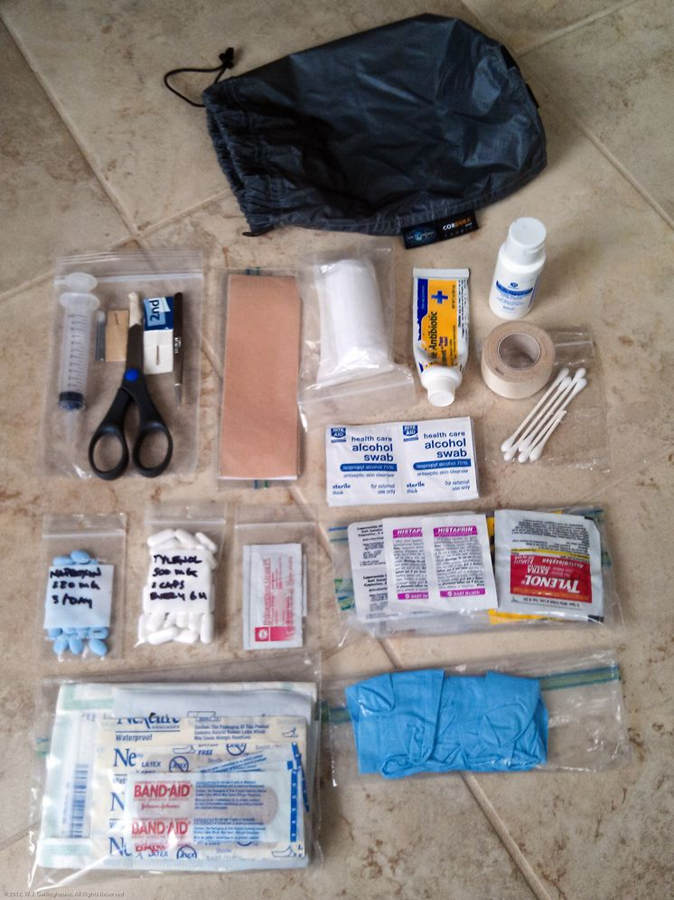
Personal First Aid Kits
Your first aid kit should be suited to the expected use and your training level.
First aid kits need to be convenient to use and in a place where they can be reached easily.

Slide 51
Personal First Aid Kit List
Six adhesive bandages.
Two 3-by-3-inch sterile gauze pads.
One small roll of adhesive tape.
One 3-by-6-inch piece of moleskin.
One small bar of soap or travel-size bottle of hand sanitizer.
One small tube of antibiotic ointment.
One pair of scissors.
One pair of non-latex disposable gloves.

Slide 52

Seven Principles of Leave No Trace
Plan ahead and prepare.
Travel and camp on durable surfaces.
Dispose of waste properly.
Leave what you find.
Minimize campfire impacts.
Respect wildlife.
Be considerate of other visitors.

Slide 53
Plan Ahead and Prepare
Proper trip planning and preparation helps hikers and campers accomplish trip goals safely and enjoyably while minimizing damage to natural and cultural resources. Campers who plan ahead can avoid unexpected situations, and minimize their impact by complying with area regulations such as observing limitations on group size. Schedule your trek to avoid times of high use. Obtain permits or permission to use the area for your trek.
Proper planning ensures:
  Low-risk adventures because campers obtained information concerning geography and weather and prepared accordingly
  Properly located campsites because campers allotted enough time to reach their destination
  Appropriate campfires and minimal trash because of careful meal planning and food repackaging and proper equipment
  Comfortable and fun camping and hiking experiences because the outing matches the skill level of the participants

Slide 54
Travel and Camp on Durable Surfaces
Damage to land occurs when visitors trample vegetation or communities of organisms beyond recovery. The resulting barren areas develop into undesirable trails, campsites, and soil erosion.
Concentrate Activity, or Spread Out?
  In high-use areas, campers should concentrate their activities where vegetation is already absent. Minimize resource damage by using existing trails and selecting designated or existing campsites. Keep campsites small by arranging tents in close proximity.
  In more remote, less-traveled areas, campers should generally spread out. When hiking, take different paths to avoid creating new trails that cause erosion. When camping, disperse tents and cooking activities–and move camp daily to avoid creating permanent-looking campsites. Avoid places where impacts are just beginning to show. Always choose the most durable surfaces available: rock, gravel, sand, compacted soil, dry grasses, or snow.

Slide 55
Dispose of Waste Properly
This simple yet effective saying motivates back-country visitors to take their trash home with them. It makes sense to carry out of the backcountry the extra materials taken there by your group or others. Inspect your campsite for trash or spilled foods. Accept the challenge of packing out all trash, leftover food, and litter.
Sanitation:
  Backcountry users create body waste and wastewater that require proper disposal.
  Wastewater. Help prevent contamination of natural water sources: After straining food particles, properly dispose of dishwater by dispersing at least 200 feet (about 80 to 100 strides for a youth) from springs, streams, and lakes. Use biodegradable soap 200 feet or more from any water source.
  Human Waste. Proper human waste disposal helps prevent the spread of disease and exposure to others. Catholes 6 to 8 inches deep in humus and 200 feet from water, trails, and campsites are often the easiest and most practical way to dispose of feces.

Slide 56
Leave What You Find
Allow others a sense of discovery, and preserve the past. Leave rocks, plants, animals, archaeological artifacts, and other objects as you find them. Examine but do not touch cultural or historical structures and artifacts. It may be illegal to remove artifacts.
Minimize Site Alterations:
  Do not dig tent trenches. Only build lean-tos, tables and chairs with materials you’ve carried or packed with you. Never hammer nails into trees, hack at trees with hatchets or saws, or damage bark and roots by tying horses to trees for extended periods. Replace surface rocks or twigs that you cleared from the campsite. On high-impact sites, clean the area and dismantle inappropriate user-built facilities such as multiple fire rings and log seats or tables.
  Good campsites are found, not made. Avoid altering a site, digging trenches, or building structures.

Slide 57
Minimize Campfire Impacts
If you build a fire, the most important consideration is the potential for resource damage. Whenever possible, use an existing campfire ring in a well-placed campsite. Choose not to have a fire in areas where wood is scarce–at higher elevations, in heavily used areas with a limited wood supply, or in desert settings.
True Leave No Trace fires are small. Use dead and downed wood that can be broken easily by hand. When possible, burn all wood to ash and remove all unburned trash and food from the fire ring. If a site has two or more fire rings, you may dismantle all but one and scatter the materials in the surrounding area. Be certain all wood and campfire debris is dead out.

Slide 58
Respect Wildlife
Quick movements and loud noises are stressful to animals. Considerate campers practice these safety methods:
  Observe wildlife from afar to avoid disturbing them.
  Give animals a wide berth, especially during breeding, nesting, and birthing seasons.
  Store food securely and keep garbage and food scraps away from animals so they will not acquire bad habits. Never feed wildlife. Help keep wildlife wild.
You are too close if an animal alters its normal activities.

Slide 59
Be Considerate of Other Visitors
Thoughtful campers respect other visitors and protect the quality of their experience.
  Travel and camp in small groups (no more than the group size prescribed by land managers).
  Let nature’s sounds prevail. Keep the noise down and leave radios, tape players, and pets at home.
  Select campsites away from other groups to help preserve their solitude.
  Always travel and camp quietly to avoid disturbing other visitors.
  Make sure the colors of clothing and gear blend with the environment.
  Respect private property and leave gates (open or closed) as found.
Be considerate of other campers and respect their privacy.

Slide 60
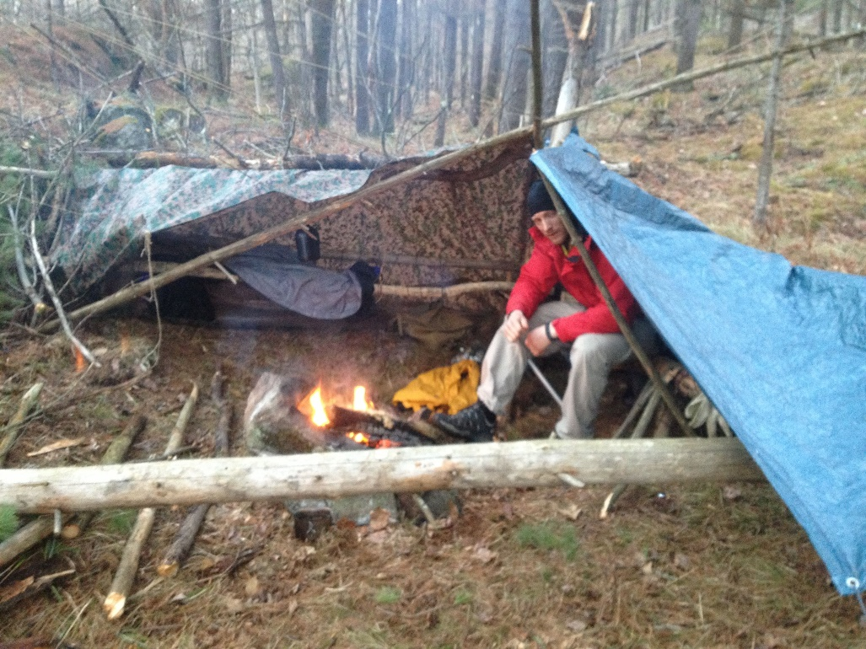
Organizing Your Winter Campout
Download the Winter Camping Preparation Form for help in organizing your winter campout and a suggested packing list.

